Slide 1
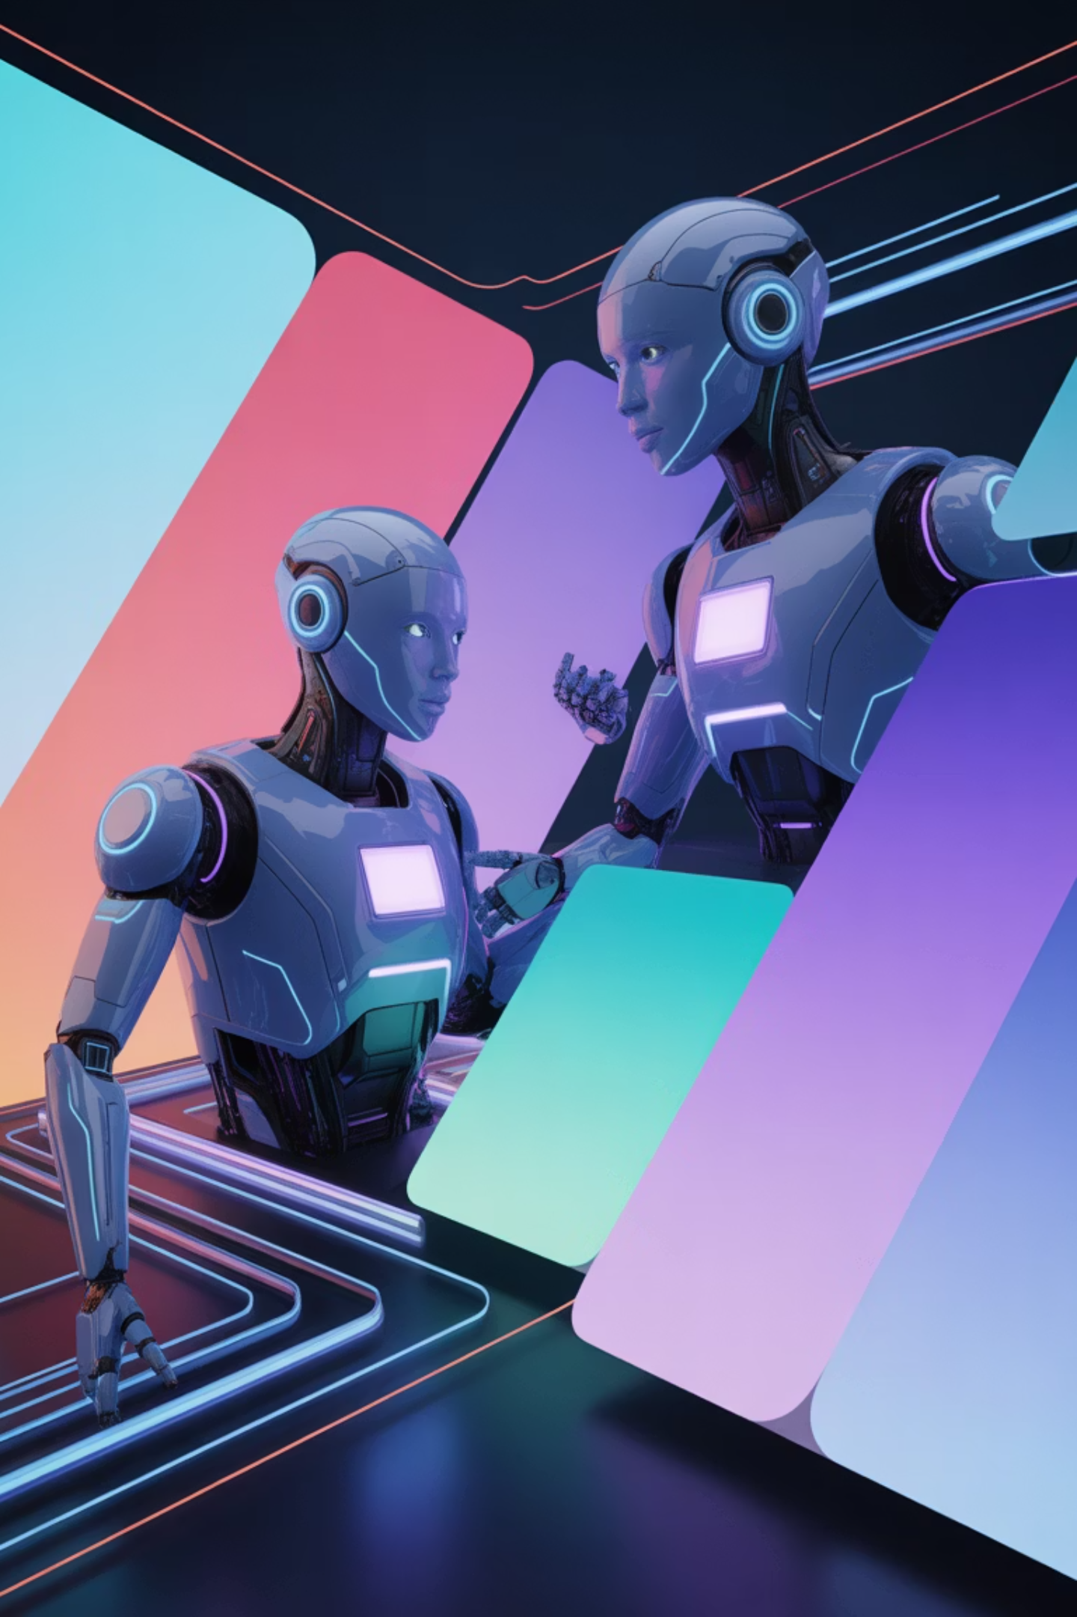
AI Agents
A comprehensive exploration of how leading AI companies conceptualize autonomous intelligent systems

Slide 2
What Are AI Agents? Industry Perspectives
OpenAI Definition
Business Perspective
AI agents are autonomous systems that can perceive their environment, make decisions, and take actions to achieve specific goals. They leverage large language models to understand context, reason through problems, and execute tasks with minimal human intervention.
AI agents are software entities designed to automate complex tasks, optimize operational efficiencies, and drive strategic outcomes within an enterprise context. They function by autonomously interpreting business objectives, engaging with various systems and data sources, and executing a sequence of actions to achieve measurable value, thereby augmenting human capabilities and transforming workflows.
Google Gemini Definition
AI agents represent autonomous systems capable of perceiving, reasoning, and acting in complex environments. They understand context, adapt to changing conditions, and execute tasks by breaking down goals into actionable steps while learning from interactions.
Technical Perspective
Anthropic Definition
From a technical standpoint, AI agents are computational systems orchestrated around a core reasoning engine, typically powered by large language models, that interact with an environment through sensors (perception) and effectors (actions). They are characterized by their ability to maintain an internal state, engage in planning, learn from experience, and adapt their behavior to achieve predefined goals, often incorporating modular architectures for specialized functions.
AI agents are systems that can perceive information, process it to make decisions, and take actions toward achieving defined goals. They demonstrate autonomy in task execution while maintaining alignment with human values and intentions.

Slide 3
Evolving from Traditional Automation to AI Agents
Automation/RPA/Traditional ML Workflow
AI Agents
Fixed rule-based processes with limited adaptability
Dynamic decision-making with contextual understanding
Requires extensive pre-programming for each scenario
Self-adapting to new scenarios and requirements
Cannot handle exceptions or unexpected situations
Handles exceptions and edge cases intelligently
Limited learning capabilities from new data
Continuous learning from interactions and feedback
Brittle when business processes change
Resilient to process changes and variations
Requires constant human oversight and maintenance
Operates autonomously with minimal supervision
Struggles with unstructured data and complex reasoning
Excels at processing unstructured data and complex reasoning
Yesterday workflows decided the output; AI Agents decide the decision

Slide 4
Taxonomy of AI Agents
Level 0: Core Reasoning System
1
The foundational language model, isolated.
Level 1: Connected Problem-Solver
2
Language model augmented with tools for real-world interaction.
Level 2: Strategic Problem-Solver
3
Adds context engineering and advanced planning capabilities.
Level 3: Collaborative Multi-Agent Systems
4
Teams of specialized agents coordinating to achieve goals.
Level 4: Self-Evolving Systems
5
Agents capable of autonomously building new tools or spawning new agents.

Slide 5
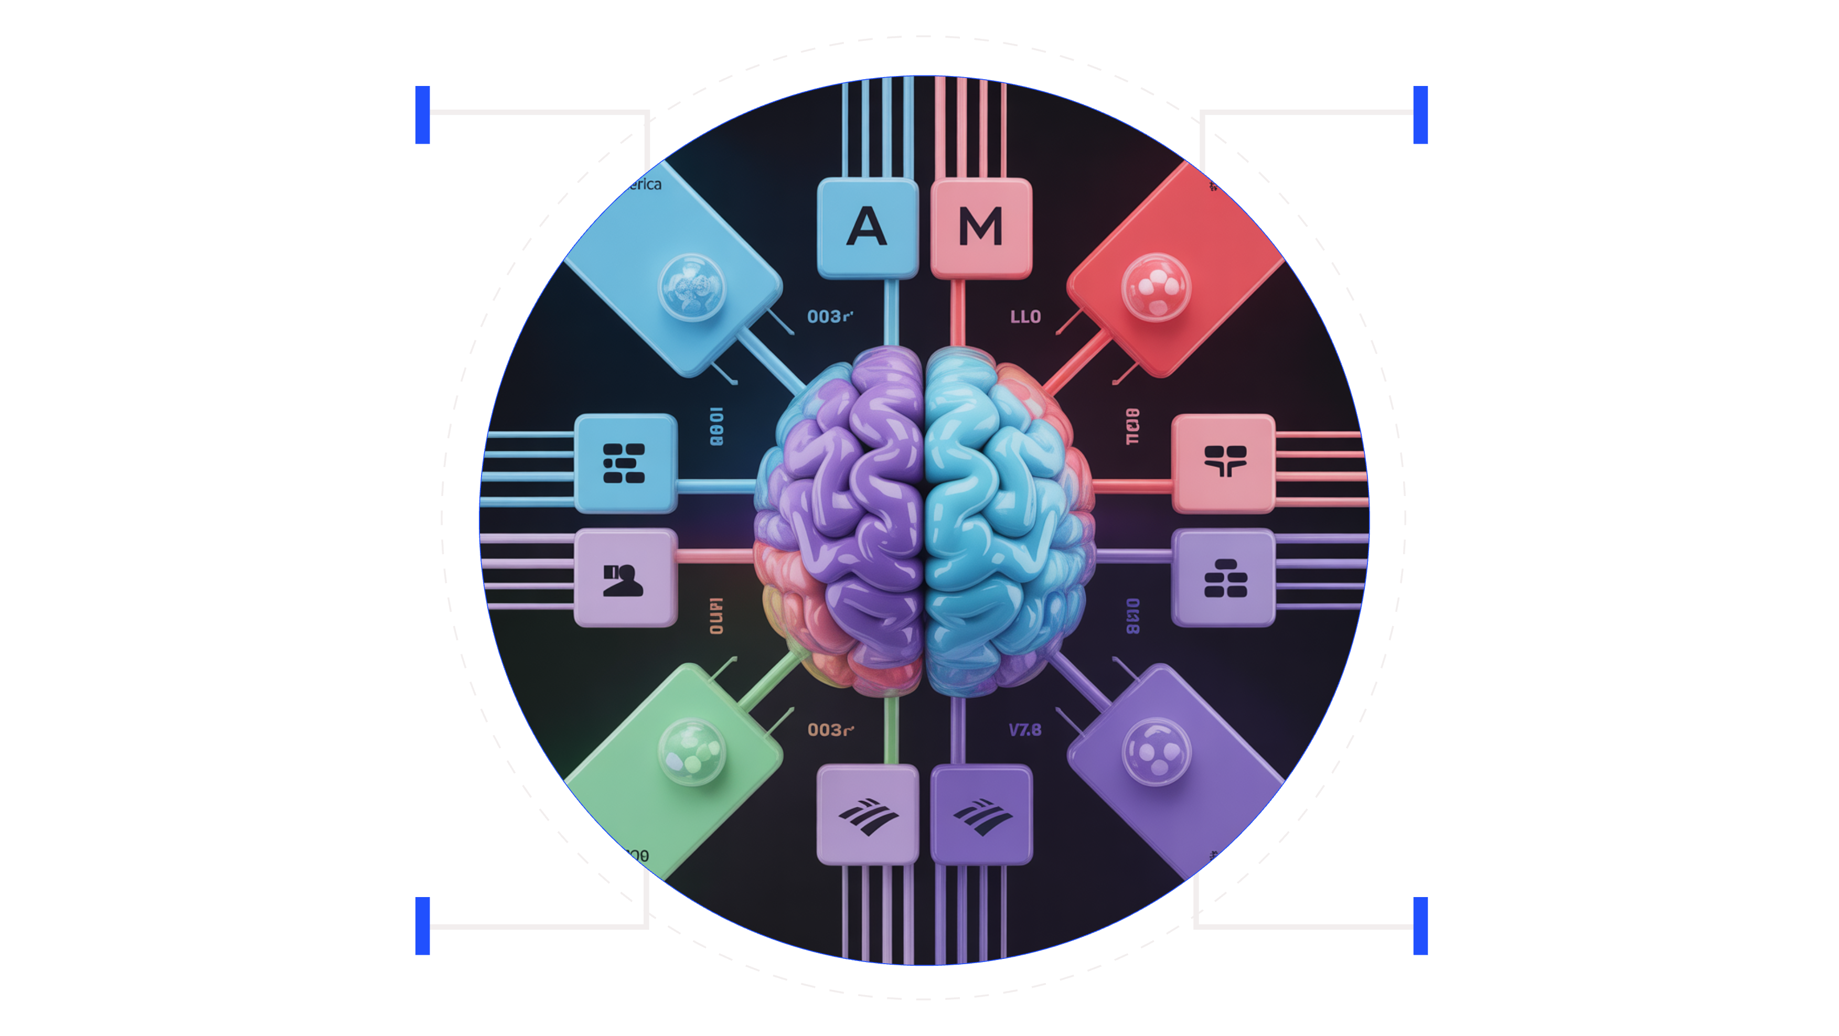
Agent Building Blocks
Brain / LLM
Tools / Hands
Reasoning core with neural patterns
APIs, interfaces, action capabilities
Memory
Body / Orchestra
Knowledge stores, retrieval, learning
Coordination and system management

Slide 6

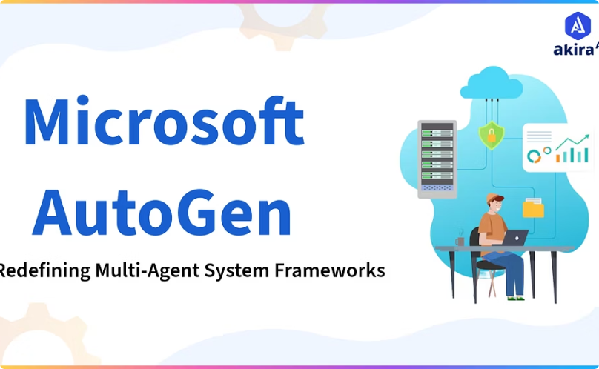

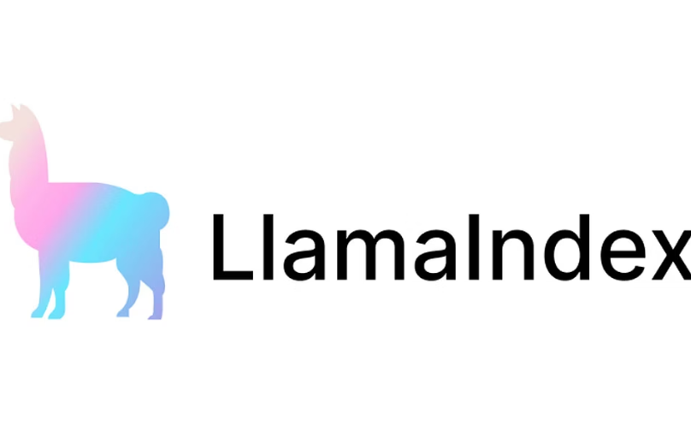

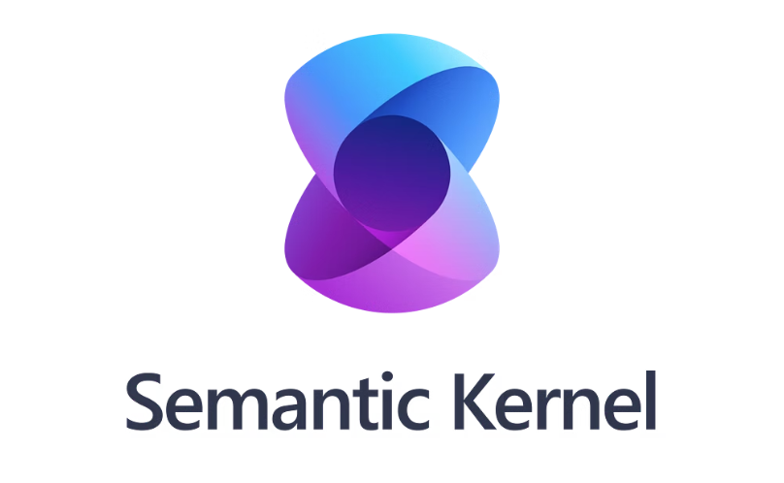
Common AI Frameworks (Pro Code)
LangGraph
AutoGen
CrewAI
LlamaIndex
Haystack
Semantic Kernel

Slide 7
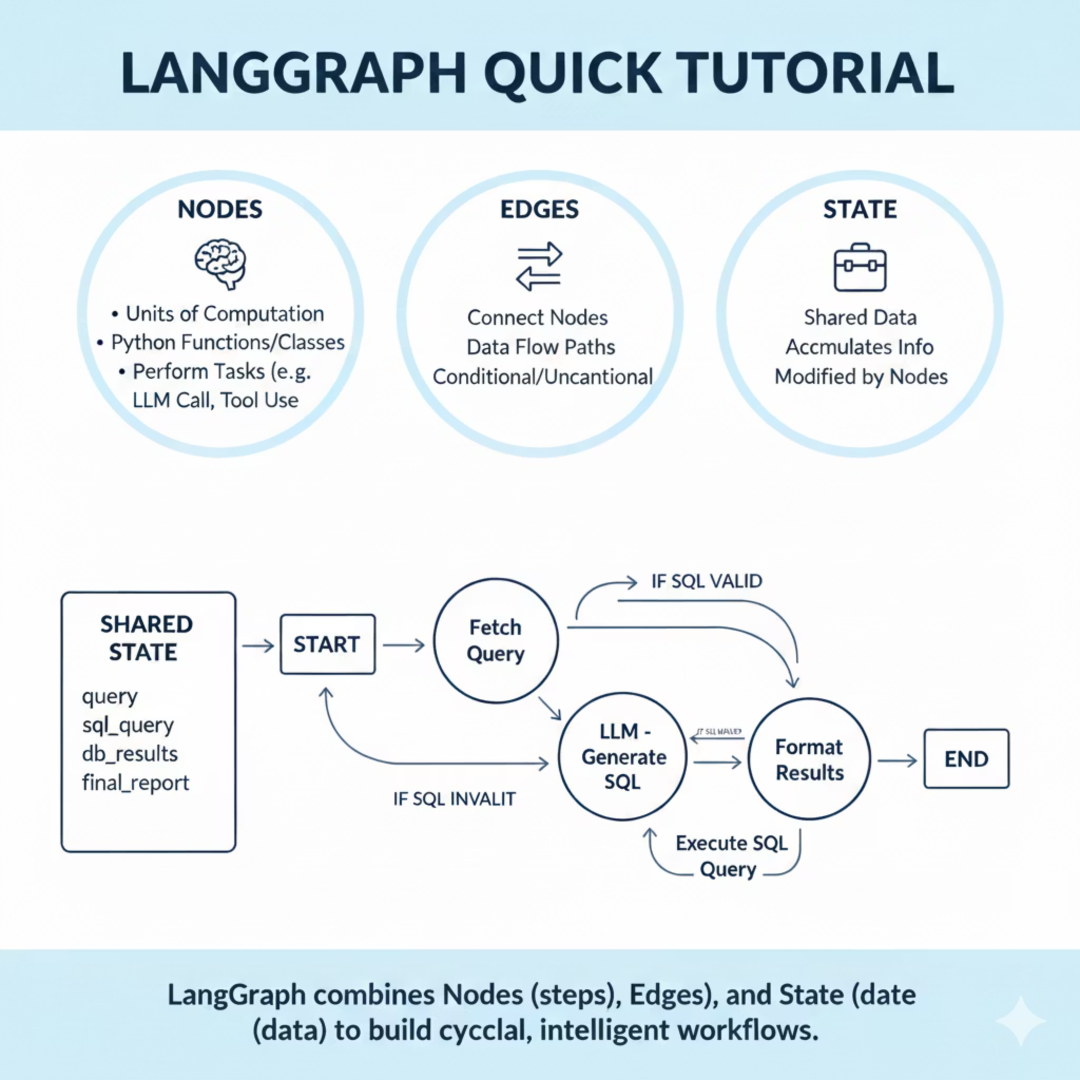
LangGraph

Slide 8
Basic Implementation
Installation:
pip install langgraph
Simple Example - Basic Chatbot:
from langgraph.graph import StateGraphfrom typing import TypedDict# Define state structureclass State(TypedDict): messages: list# Define nodesdef chatbot_node(state: State): # Process user message response = generate_response(state["messages"][-1]) return {"messages": state["messages"] + [response]}# Build the graphworkflow = StateGraph(State)workflow.add_node("chatbot", chatbot_node)workflow.set_entry_point("chatbot")workflow.set_finish_point("chatbot")# Compile and runapp = workflow.compile()result = app.invoke({"messages": ["Hello!"]})
Key Steps:
Define your state structure
Create node functions
Build the graph with nodes and edges
Compile and execute

Slide 9
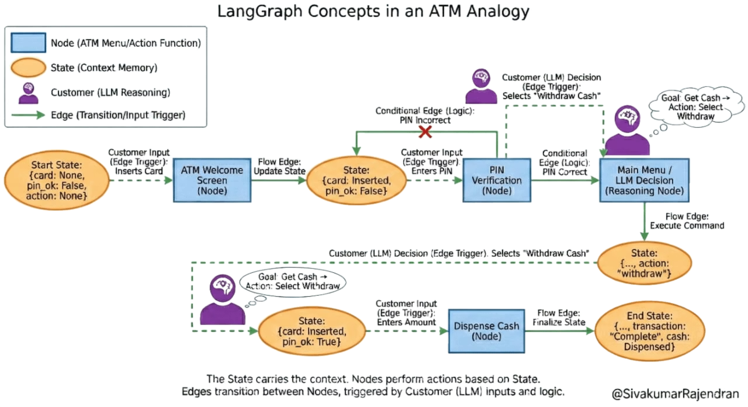
LangGraph Concepts in ATM Analogy

Slide 10
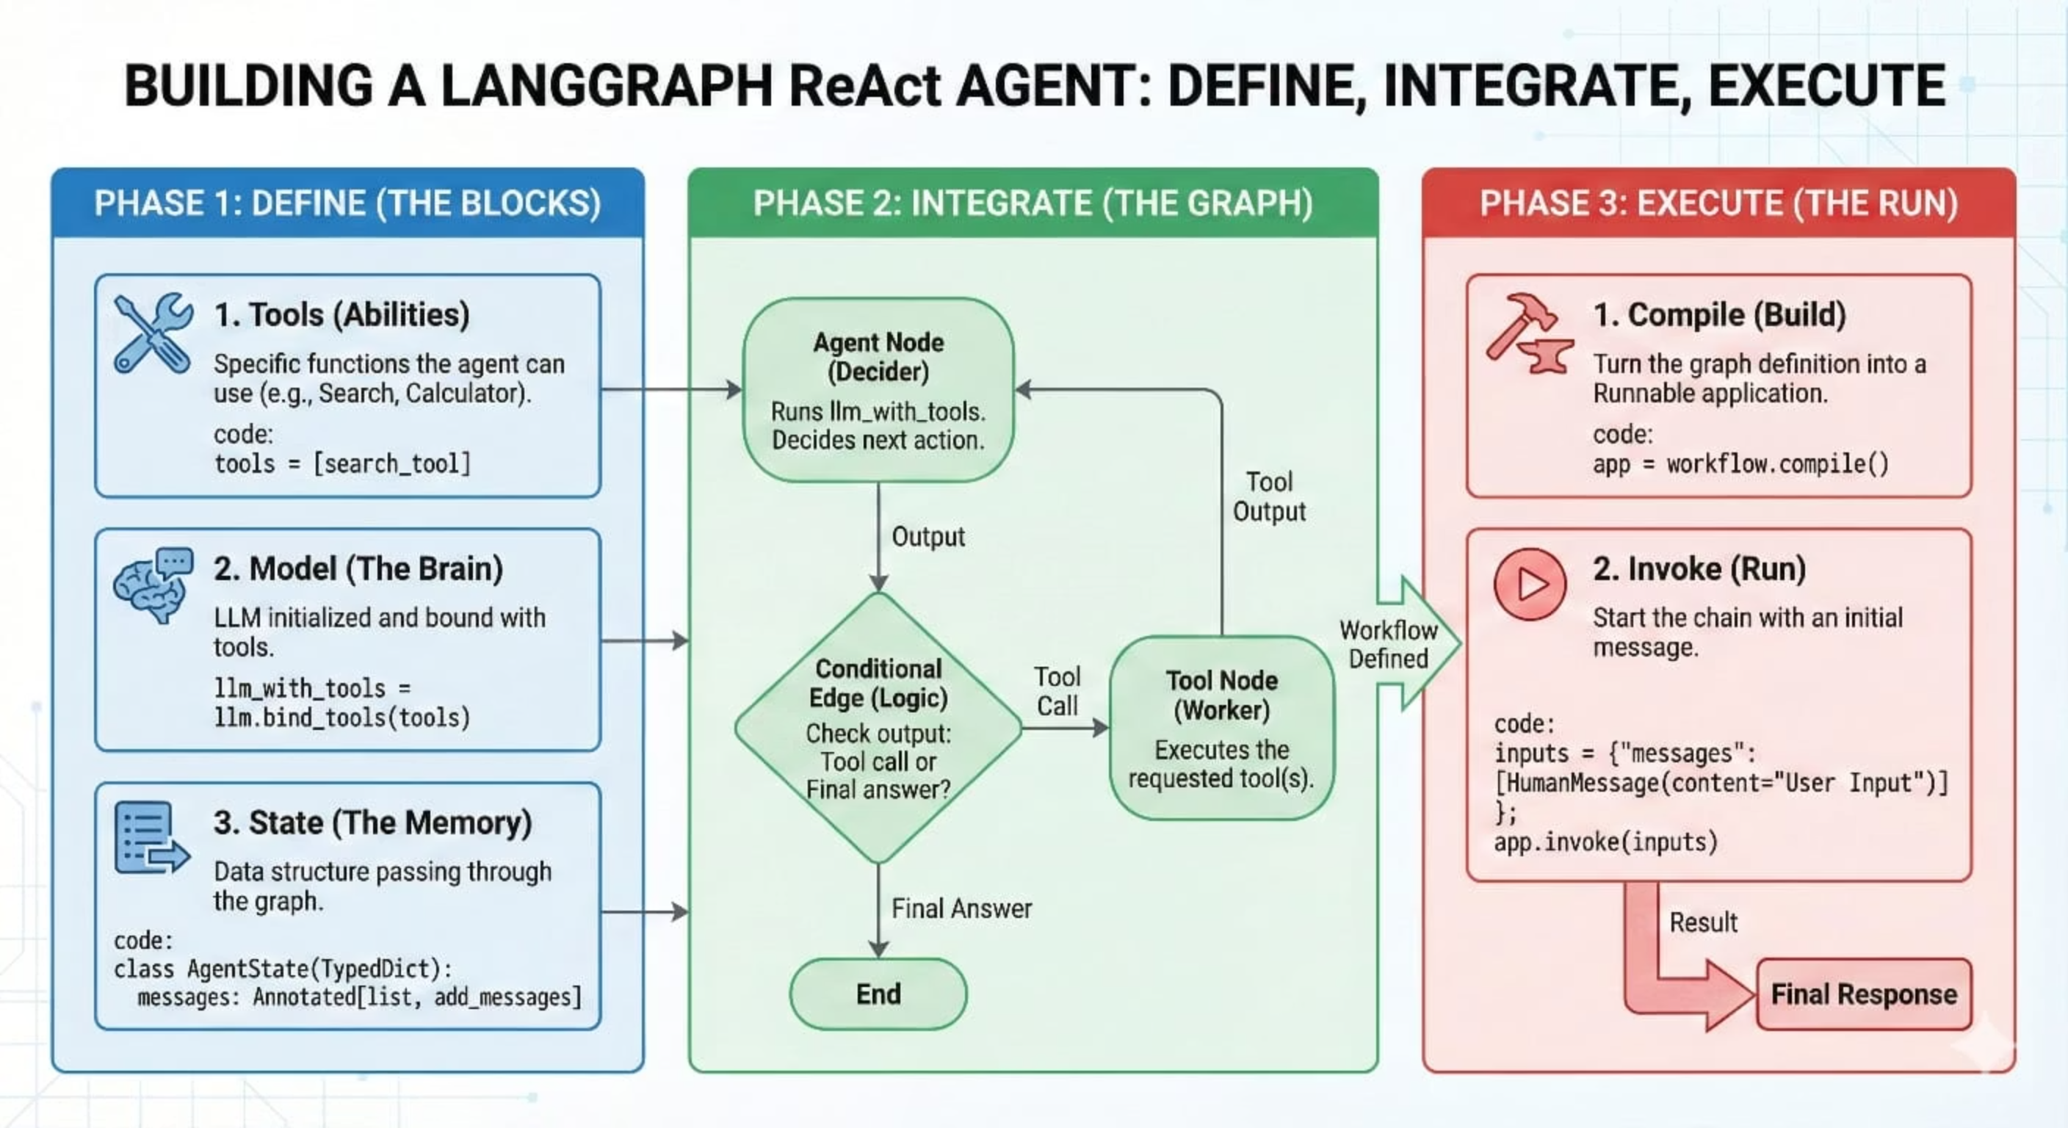
Building a LangGraph ReAct Agent: Define, Integrate, Execute

Slide 11
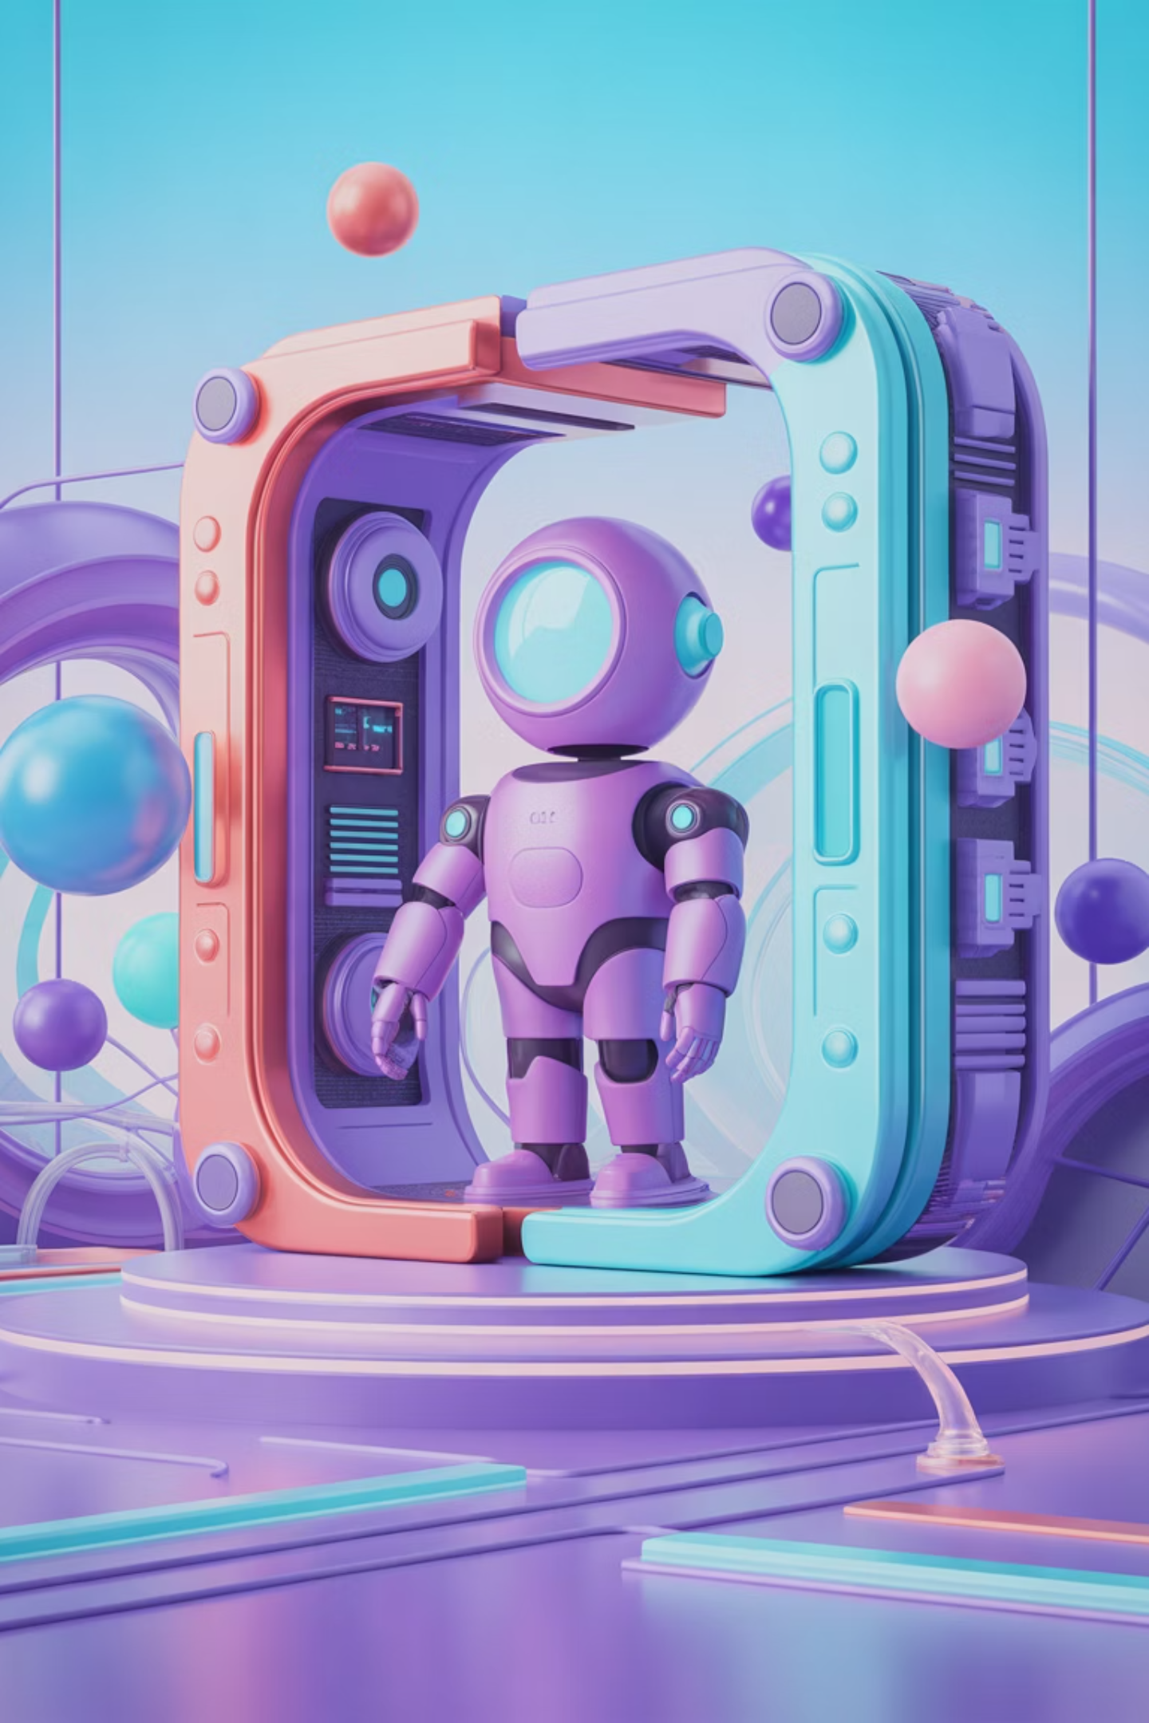
Let's create a simple agent

